Slide 1


Mukwonago Lacrosse Club
Parent Meeting

Slide 2
BOARD MEMBERS
Kate Kim - President
Dave Hoffman- Vice President
Renee Moss - Secretary
Joseph Scheuring - Treasurer
Vacant - Boys Youth Director
Kevin Kiesgen - Boys Coaching Director
Dionna Krall - Girls Youth Director
Derek Moss- Girls Coaching Director

Slide 3
OUR MISSION
The primary goal of the Mukwonago Lacrosse Club is to develop a positive environment where youth have an opportunity to play lacrosse, athletes are able to learn and improve lacrosse skills, and to promote and expand lacrosse.
Emphasis will be placed on showing respect for individuals, teams, coaches, officials and serving as positive role models within our school and community.
Players will develop self-confidence, good sportsmanship, and a passion for the sport of lacrosse.

Slide 4

COACHESBoC
BOYS YOUTH
U8 - Jason McGillivray, Tom Langelier, Kevin Kiesgen
U10- Jason McGillivray, Matt Gluszcz,Peter Grove
Dan Sivilotti
U12- Kevin Kiesgen, Rickey Murphy, Billy Plant
Tyler Dums
U14 - Brad Friedrich
GIRLS YOUTH
U8 - Kate Kim & Katie Comfort
U10 - Jen Adler
U12 - Derek Moss
U14 - Nick Bently & Liz Dums

Slide 5
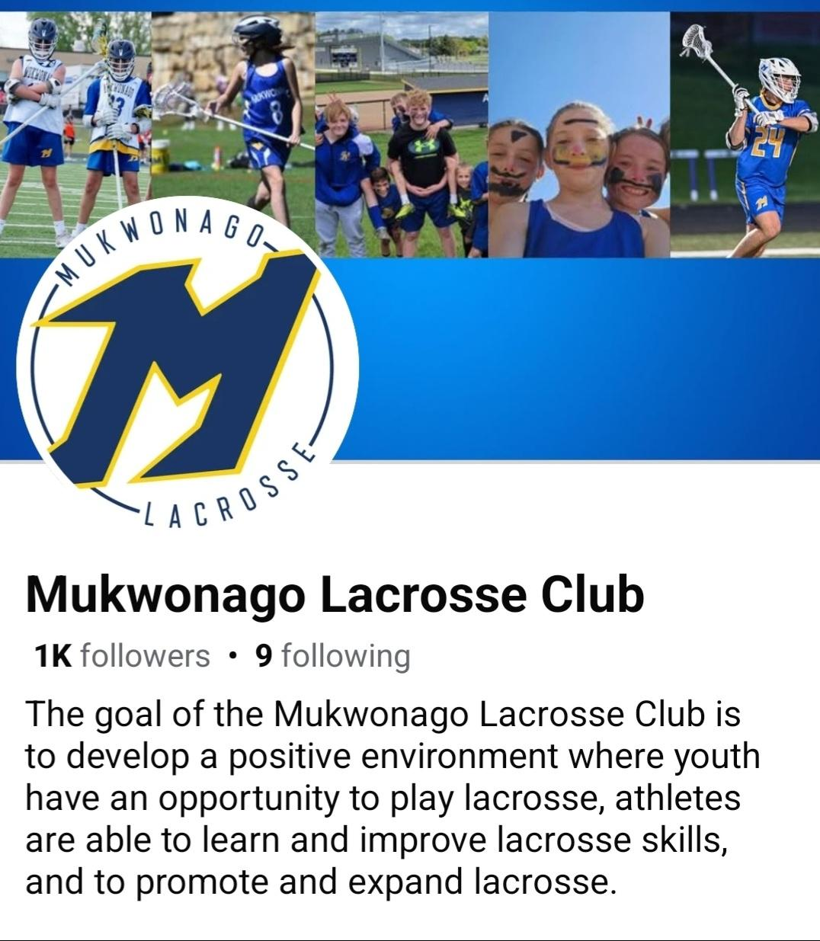


Stay Connected
Monthly Newsletters
Emails from the Secretary

Slide 6
TOURNAMENT/ INVITATIONAL SCHEDULE
Badger Spring Invite - April 25th (BY) / April 26th (GY)
Top Cheese -May10th & 11th (BY) & May 2nd (GY)
M&M Invitational - May 16th (BY) & 17th (GY)
Brookfield - May 30th (BY) & May 31st (GY)

Slide 7
PRACTICE SCHEDULE APRIL 1st - JUNE 8th
Boys Youth-Eagle Town Park
Tuesday & Thursday
U8 5:30-7:00
U10-U14 5:30-7:30
Girls Youth-Eagle Town Park
Monday & Wednesday
U8 5:30-7:00
U10-U14 5:30-7:30

Slide 8
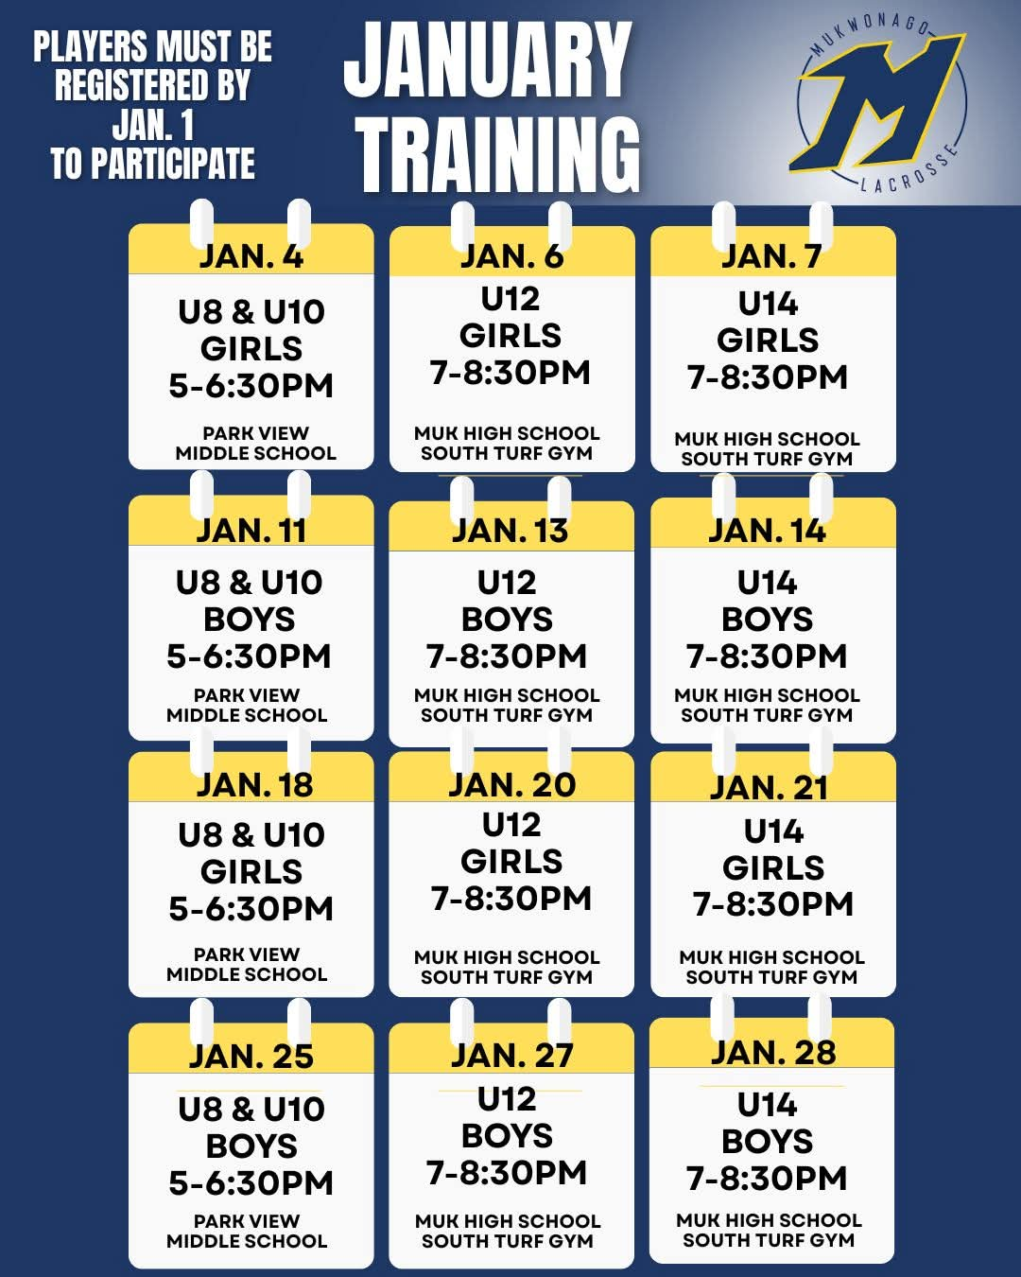
WINTER TRAINING BOYS YOUTH

Slide 9
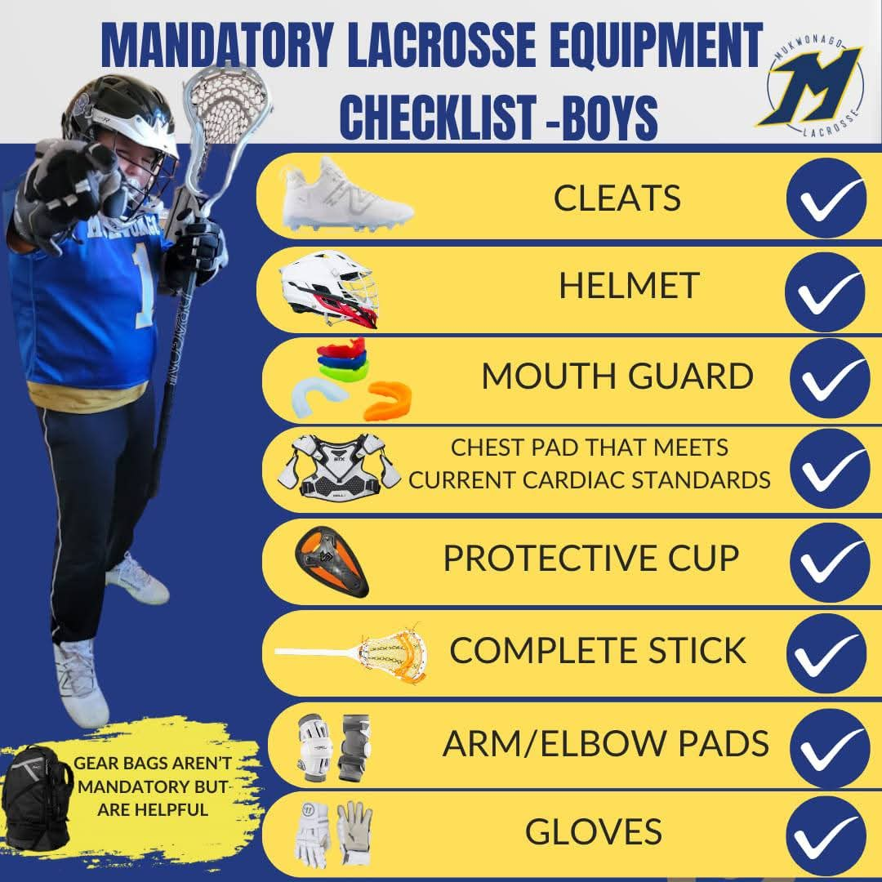

EQUIPMENT REQUIREMENTS - BOYS
Equipment information can be found on our website
MUST be NOCSA certified (boys)

Slide 10
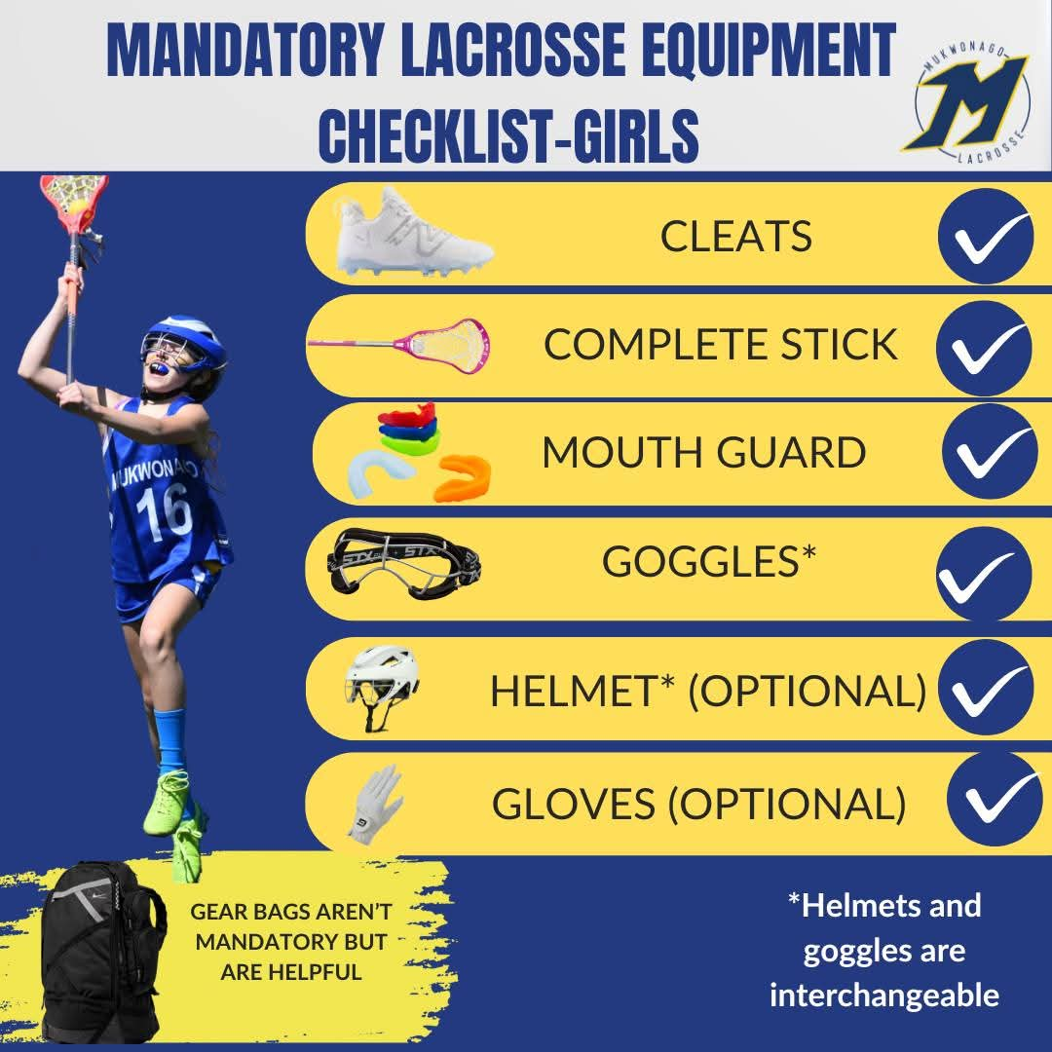
EQUIPMENT REQUIREMENTS - GIRLS YOUTH
Equipment information can be found on our website

Slide 11

FUNDRAISING - SIP & SUPPORT
Saturday, March 14th 2026
7pm-??? at Morningstar Golfers Club
Sample curated Bourbon & Wine.
Enjoy a variety of light appetizers.
Silent Auction & Raffle.

Slide 12
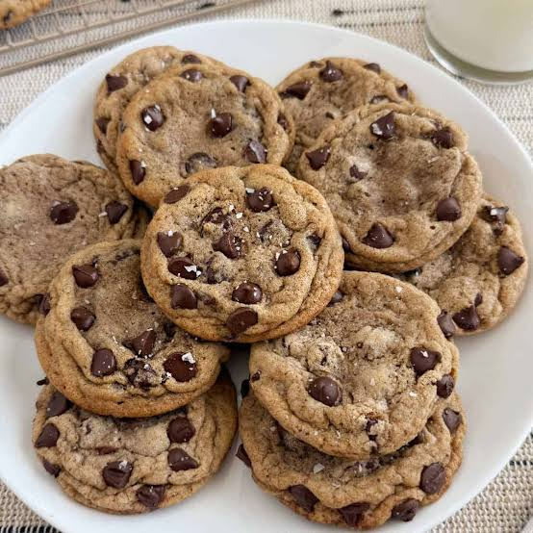
Cookie Dough
Partnering with Learning Edge Fundraising
$25/ tub
More details will be coming next month
Flavors:
Chocolate Chip
Peanut Butter
Snickerdoodle
Oatmeal Raisin
Candy (MM)
White Chocolate Macadamia Nut

Slide 13


VOLUNTEERING
$400 Volunteer Check Collected = 5 Dibs

Slide 14
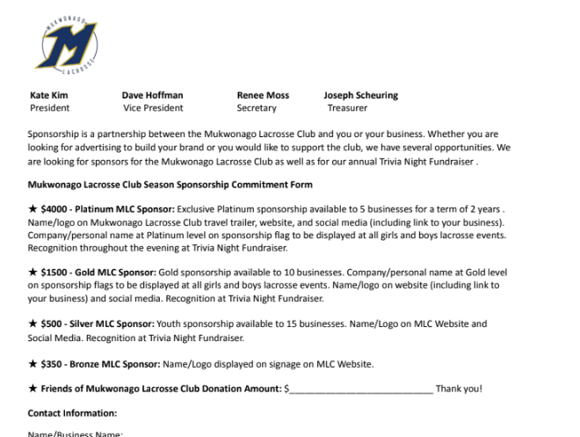
SPONSORSHIP

Slide 15
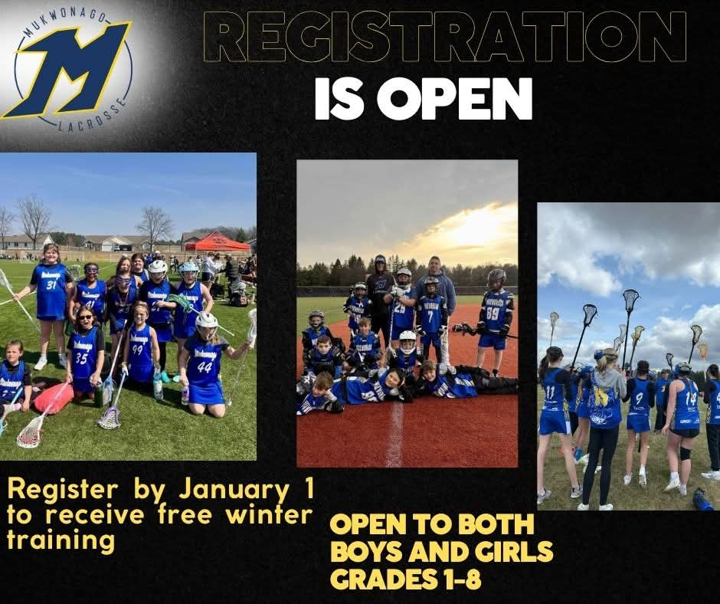
REGISTRATION ENDS
MARCH 14th

